Slide 1
ONLINE MUSIC PLAYER
With Virtualization

Slide 2
Introduction
This is a project report on “ONLINE MUSIC PLAYER”. During the making/developing of this project we explored new ideas and functionality behind the working of a JavaScript.
This project is designed by JAVASCRIPT. JavaScript is a client-side scripting language, which means the source code is processed by the client’s web browser rather than on the web server.
This means JavaScript functions can run after a webpage has loaded without communicating with the server. For example, a JavaScript function may check a web form before it is submitted to make sure all the required fields have been filled out.
Our project “ONLINE MUSIC PLAYER” is not only site for Music lovers. This is a web based application which helps people to find and listen latest songs with different languages on internet.

Slide 3
Technologies Used
HTML
CSS
JavaScript
jQuery
Bootstrap
Animation
Data Table API
Visualization API
Font Awesome
Xampp Server

Slide 4
System Requirements
Requirement Analysis
HARDWARE AND SOFTWARE USED:
Hardware:
Hardware Environment (Deployment Server)
PC | Linux Server or windows
Processor | Intel i5 or i3
RAM | 8 GB RAM
HDD | 1 TB
Monitor | Color Monitor
Network | Any network supporting TCP/IP

Slide 5
Software Requirements:-
Software Environment (Deployment Server)
Operating System | Linux and windows 8 or higher
Application Server | WampServer or XAMPP Server
Web Browser: | Google Chrome or Mozilla Firefox
Other software | HTML/Ajax/JavaScript/CSS/Bootstrap/Data Table API/Visualizer API/Animation flash 11

Slide 6
Functionality
Data Table
Music Player
Visualization
It uses Data table API functions to manipulate data such as ordering the data in alphabetical order, sorting or searching a particular file according to their name etc. All the data files are stored in a single data table and are sorted and searched accordingly using API keys.
Music player function has been used to play music files being used in this project. The music player function plays a single song at a time and provides various options such as pause, play, shuffle, forward and repeat the song at any time.
Visualization effects have been also used in this project that includes effect visualizations such as treble effects and bass effects. These effects are visualized on basis of sudden change in treble and bass values.

Slide 7
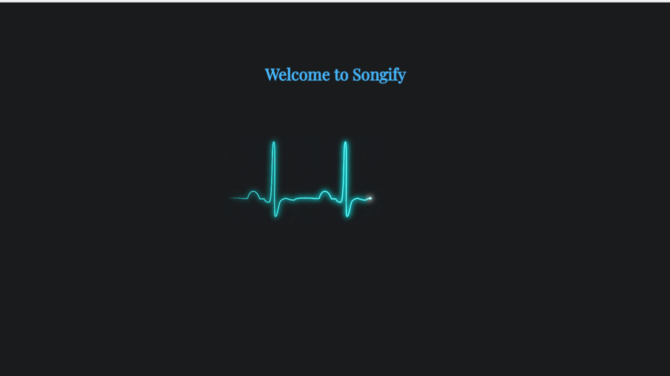
Result and Conclusion
Welcome Page

Slide 8
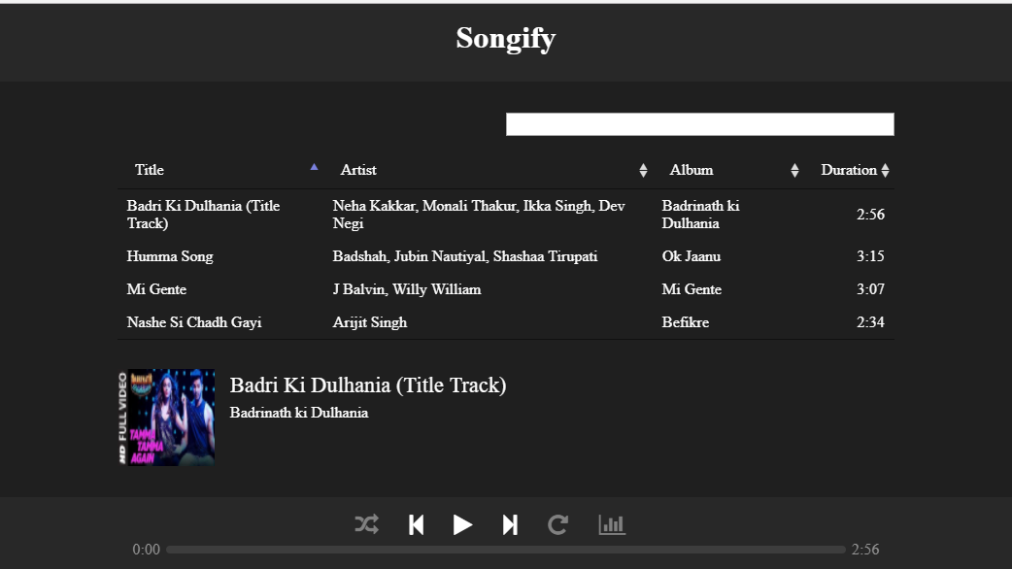
View Music Player :- It displays the list of all songs with search bar to search a particular track it also displays track images and player options.

Slide 9


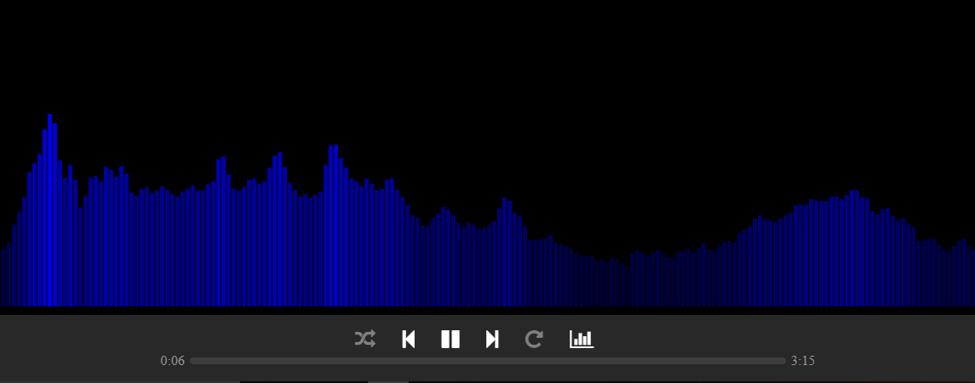



Visualizer Page
Visualization effects have been also used in this project that includes effect visualizations such as treble effects and bass effects

Slide 10
Practical use of Project:-
For Online song streaming & downloading purposes.
Good place for music lovers.
Easy to access and play music.
Music lovers can enjoy effect of visualization and dynamic effects.

Slide 11
What is Xampp server?
XAMPP is a free and open source cross-platform web server solution stack package developed by Apache Friends, consisting mainly of the Apache HTTP Server, MariaDB database, and interpreters for scripts written in the PHP and Perl programming languages.

Slide 12
What is JavaScript?

